Slide 1
UK Train Ride Analysis

Slide 2
Team Members
Ahmed Sobhy Saleh
Mohamed Ramadan Mohamed
Ramez Mamdouh Hanna
Shireen Talaat Mohammed Zayed

Slide 3
Agenda
Introduction
Data Source
Project Stages
Visualizations

Slide 4
Project Overview
This project analyzes real UK rail ticketing and journey data to:
Measure on-time performance
Identify causes of delays and cancellations
Understand passenger booking behavior (ticket types, railcards, peak travel)
Map route-level reliability and demand

Slide 5
Project Idea and Objective
Key Questions We Answer:
1. Operational Performance Overview
How many journeys are on time vs delayed?
What are the main reasons for delays?
How does delay duration vary by route or day of week?
Are refund requests correlated with delays?
2. Revenue & Ticketing Insights
How does revenue vary by ticket type, class, or rail card?
What’s the average ticket price by route or purchase method?
When are most tickets purchased (lead time)?
Which payment methods are most popular?

Slide 6
Project Idea and Objective
Key Questions We Answer:
3. Weather Impact on Train Operations
Does weather (rain, wind, temperature) affect delays?
Are certain routes more weather-sensitive?
How does precipitation correlate with journey status?
4. Customer Journey & Behavior
What are the busiest travel days/times?
How does journey duration vary by departure time?
Which routes are most popular?
Do rail card holders travel differently?

Slide 7
Project Stages
Cleaning
Modeling
DAX
Sample Visuals
Reports
Dashboard

Slide 8
Data Sources
From DEPI CSV file (Railway)
Station Location Data (Geocoding): Manually created from Ordnance Survey. Retrieved from ordnance survey Network Rail Open Data Feeds. Retrieved from UK network rail
Weather Data Retrieved from weather API with historical data. open-meteo Then used downloaded CSV file.
Public Holiday Calendar Manually created from https://www.gov.uk/bank-holidays

Slide 9
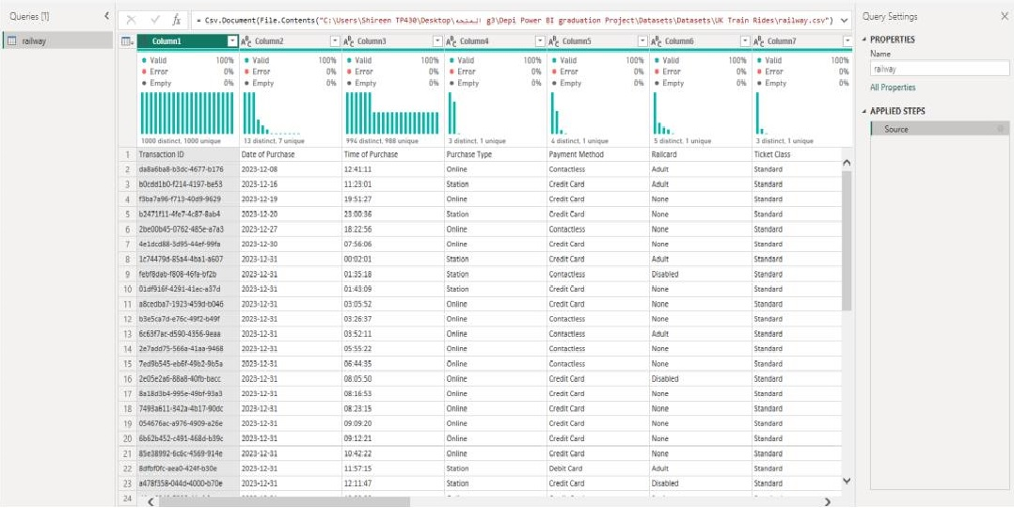
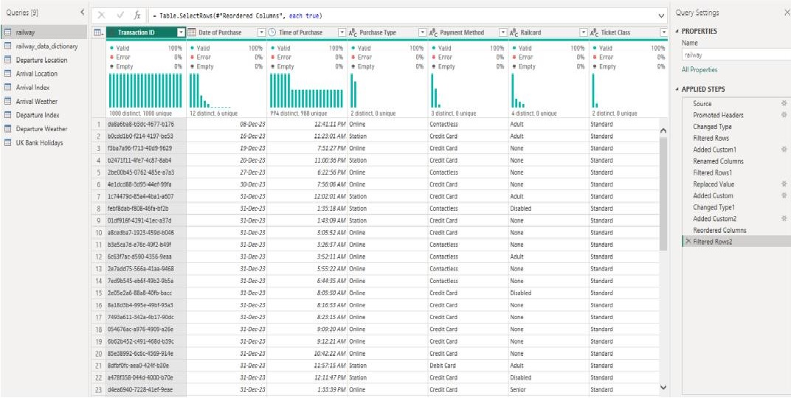
Cleaning Steps
Data Before Cleaning Data After Cleaning

Slide 10
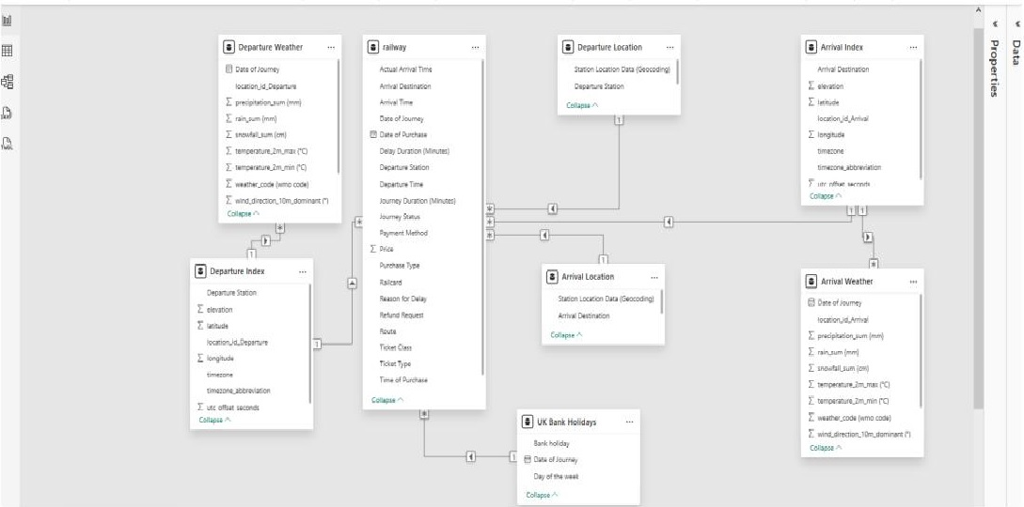
Data Modeling

Slide 11
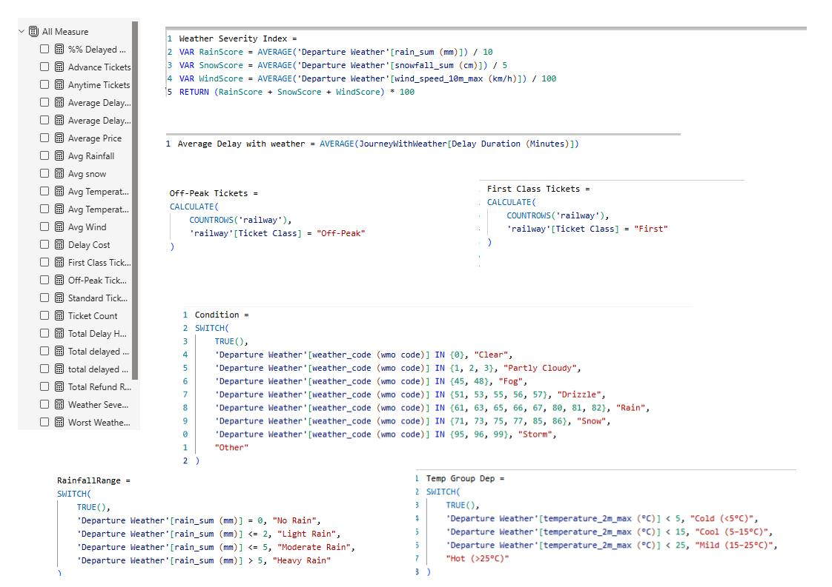
DAX

Slide 12
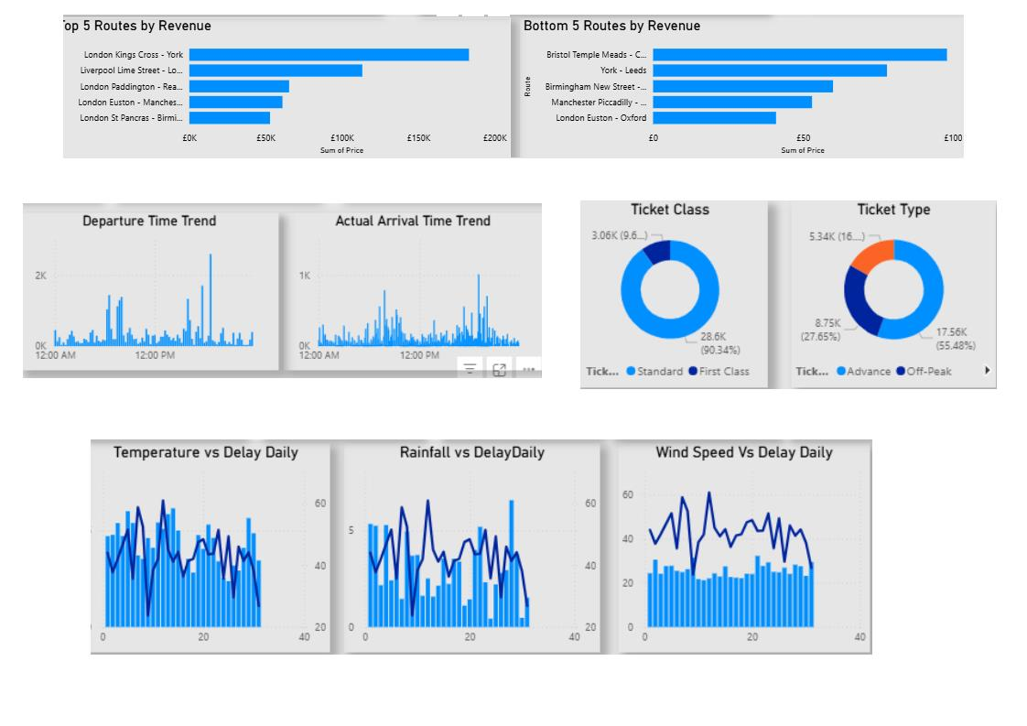
Sample Visuals

Slide 13
Reports

Slide 14


Microsoft Power BI – Operational Performance

Slide 15
Microsoft Power BI – Sales Performance

Slide 16
Microsoft Power BI – Weather Impact

Slide 17
Microsoft Power BI – Passengers Behaviour

Slide 18
Dashboard

Slide 19
Microsoft Power BI – Overview Dashboard

Slide 20
Q&A Session

Slide 21
Thank You!

